Slide 1
How migrants can better adapt?
Farid Mammadaliyev

Slide 2

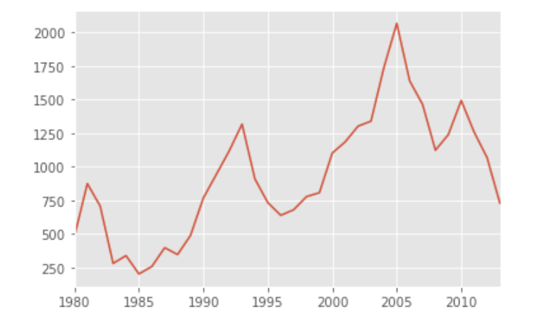
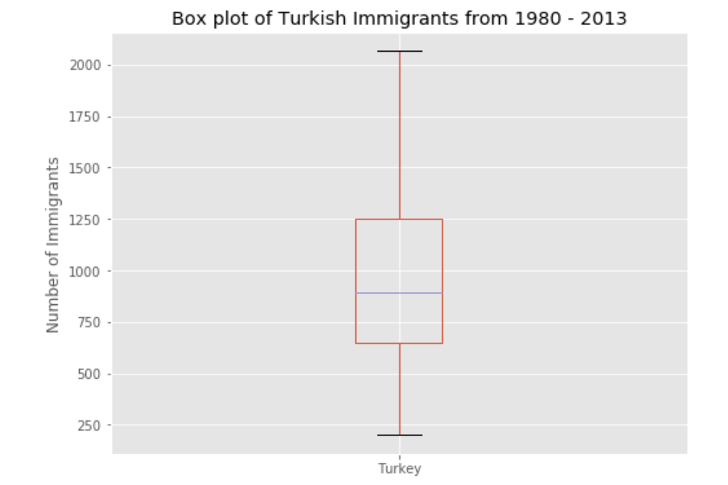
Immigration from Turkey to Canada

Slide 3

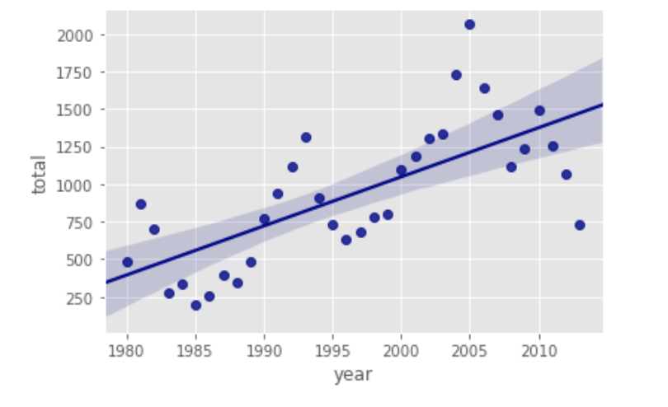
Immigration trend from Turkey to Canada

Slide 4

Data sources
Migration data: Statistics Canada
Toronto’s neighborhoods: Wikipedia
Istanbul’s neighborhoods: ww.worldpostalcode.com
Venues’ coordinates: Foursquare API

Slide 5
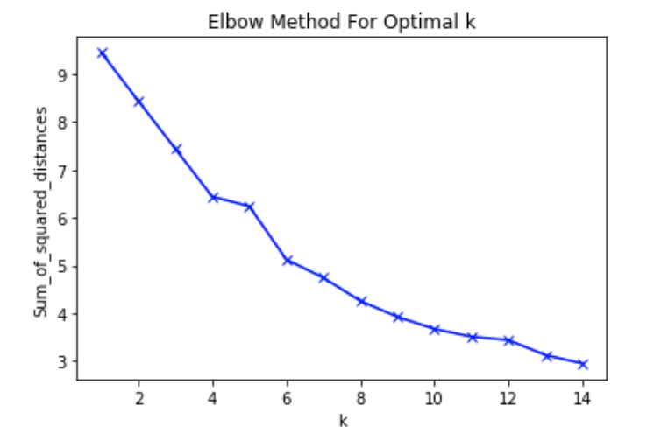
Methodology: K - Means clustering

Slide 6
Methodology: Hierarchical clustering
Number of clusters: 6
Maximum number of clusters: 12
Type of distance: Euclidean

Slide 7
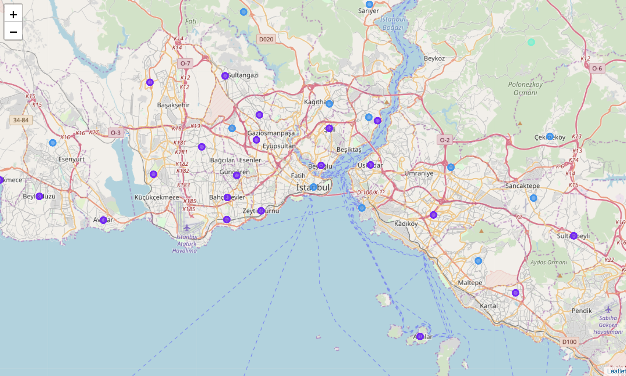

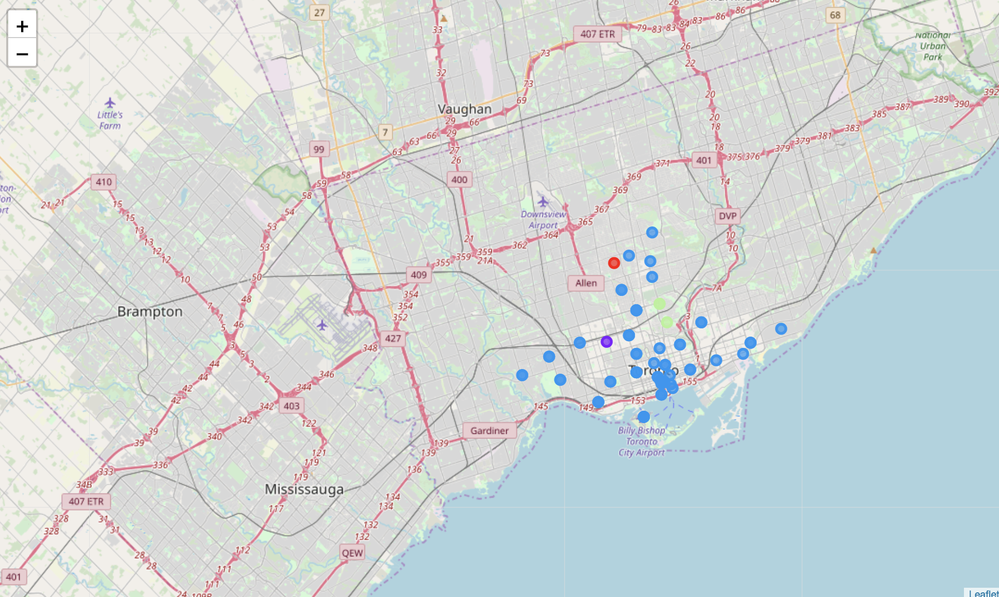
Results: K - Means
The map on the top: Istanbul
The map on the bottom: Toronto
Note: the same colors represents similar neighborhoods based on venue categories

Slide 8
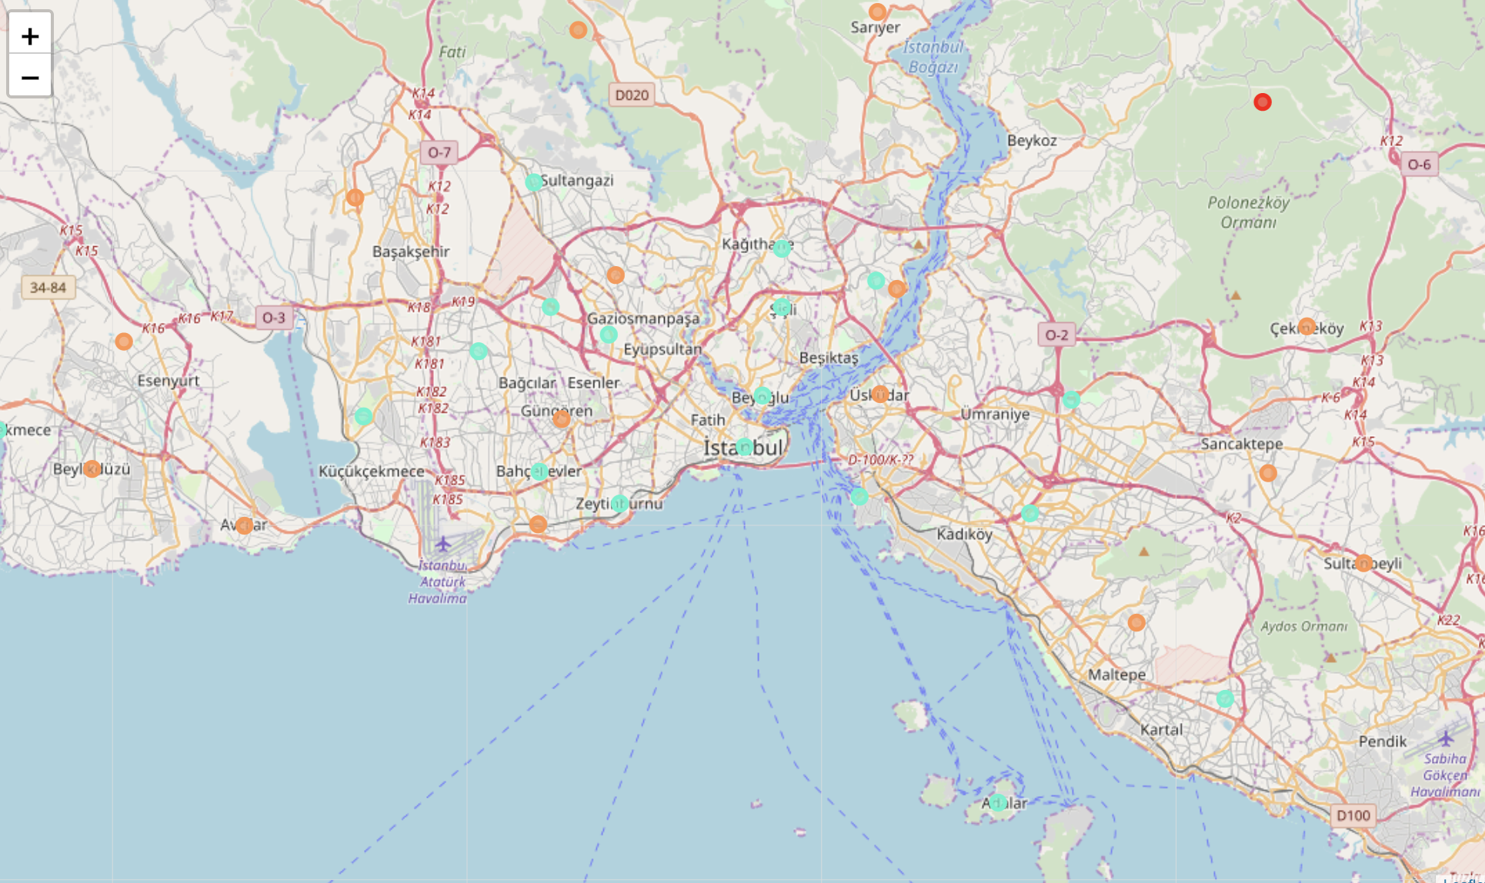
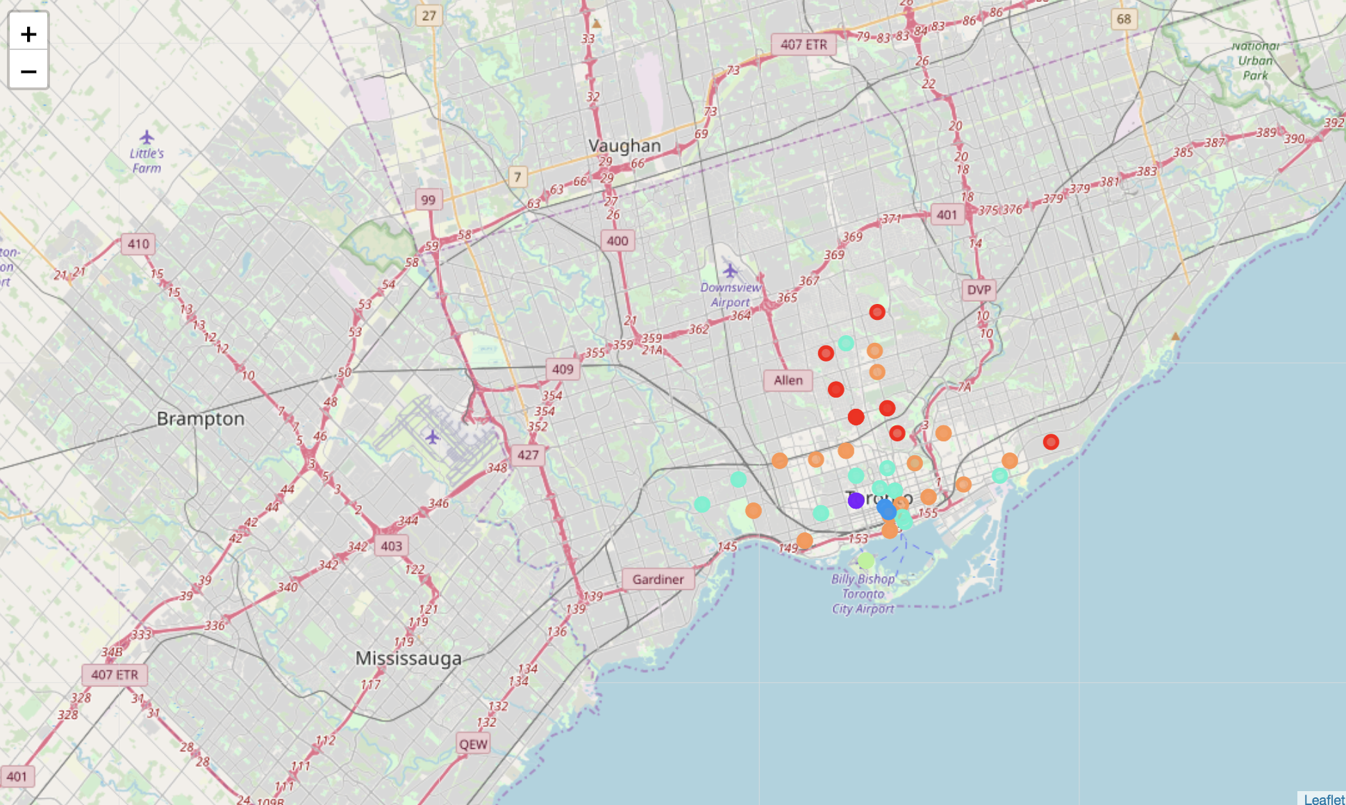
Results: Hierarchical
The map on the top: Istanbul
The map on the bottom: Toronto
Note: the same colors represents similar neighborhoods based on venue categories

Slide 9
Conclusion
I found that Istanbul and Toronto had many comparable neighborhoods
Toronto’s some neighborhoods do not have alternatives in Istanbul
Istanbul’s some neighborhoods do not have alternatives in Toronto

